Slide 1
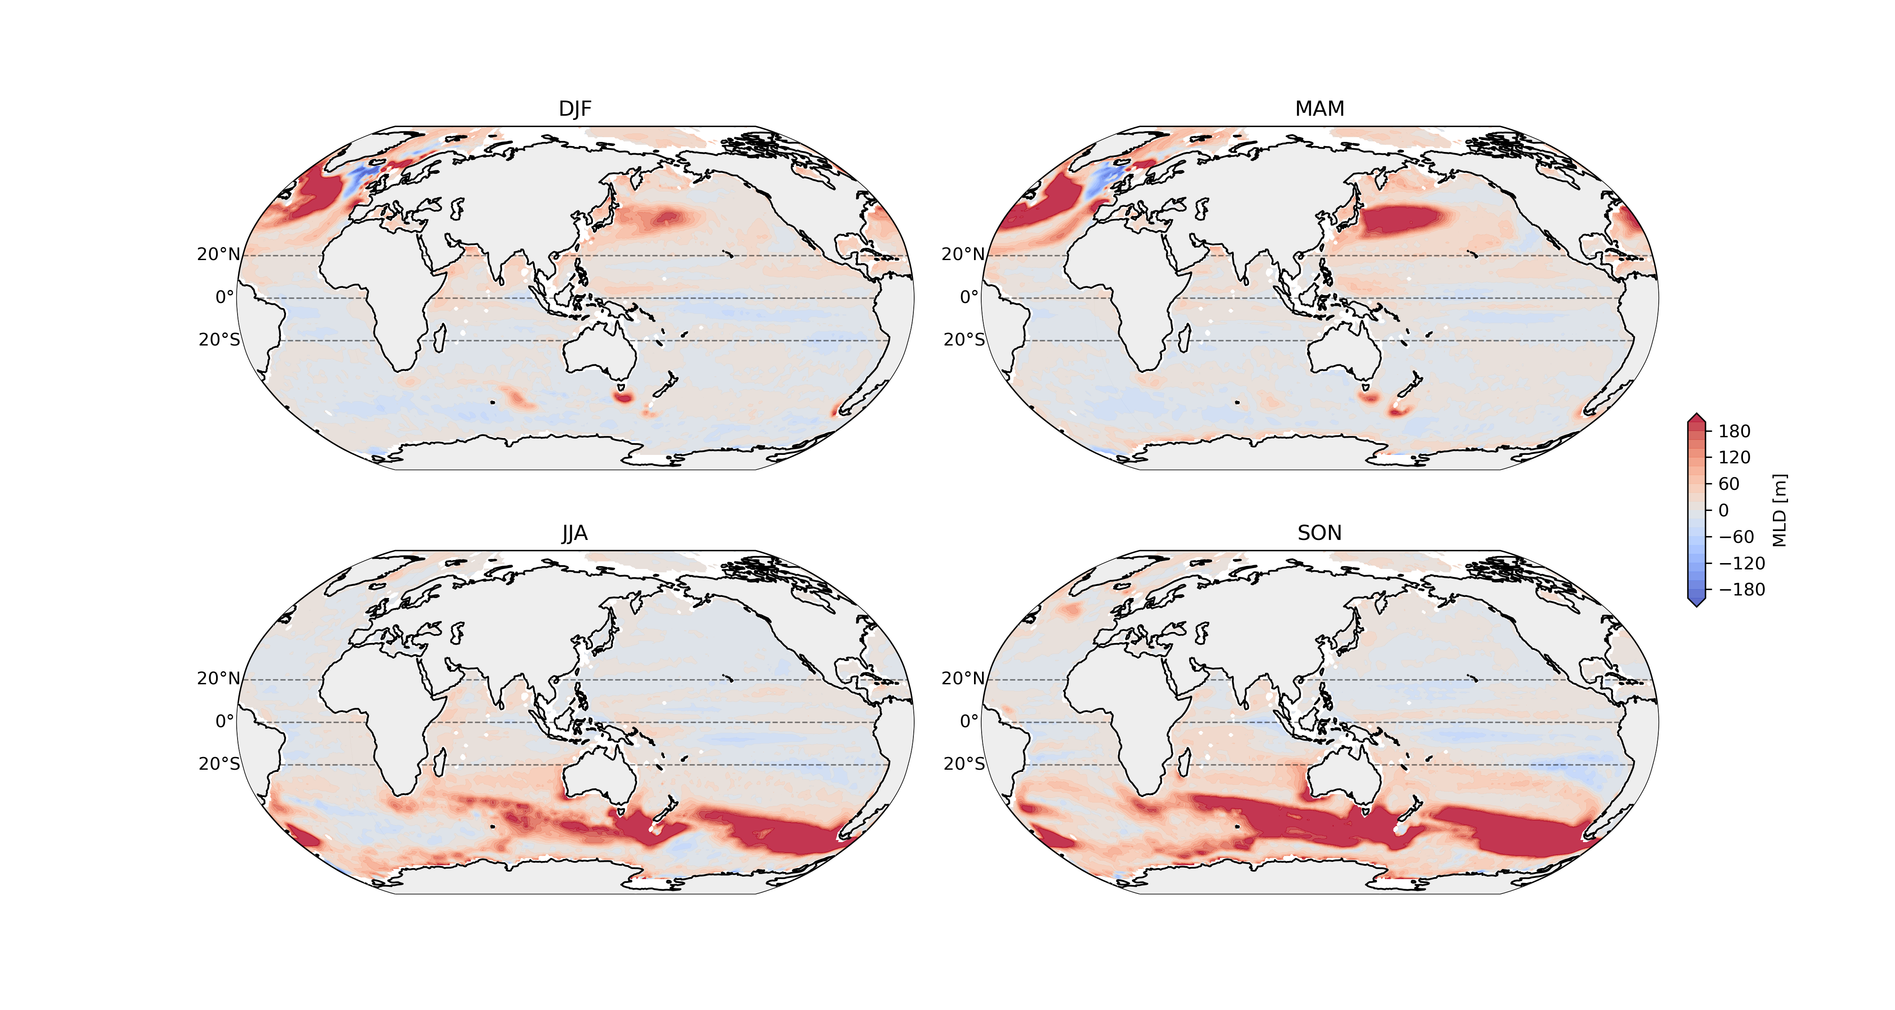
MLD bias (CMIP6_ensemble_mean – CORA) 1970-2014

Slide 2
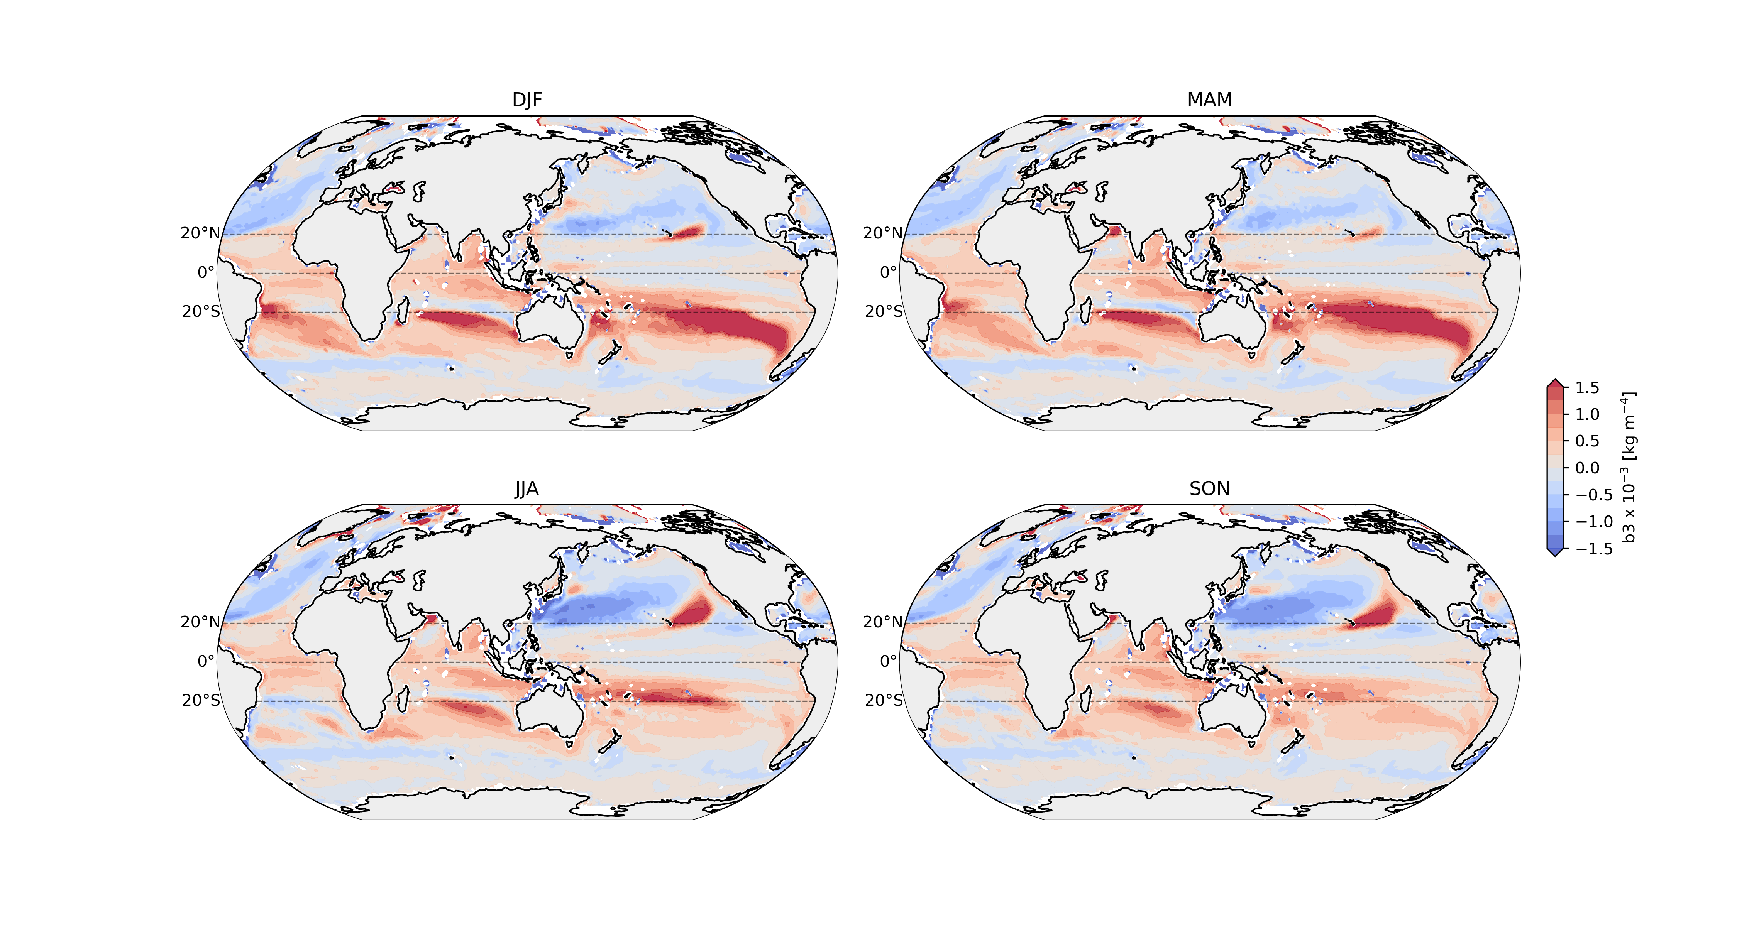
b3 bias (CMIP6_ensemble_mean – CORA) 1970-2014

Slide 3
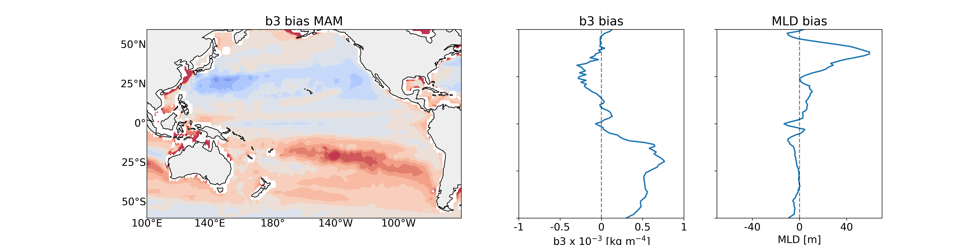
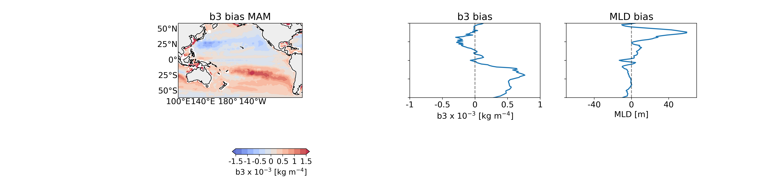
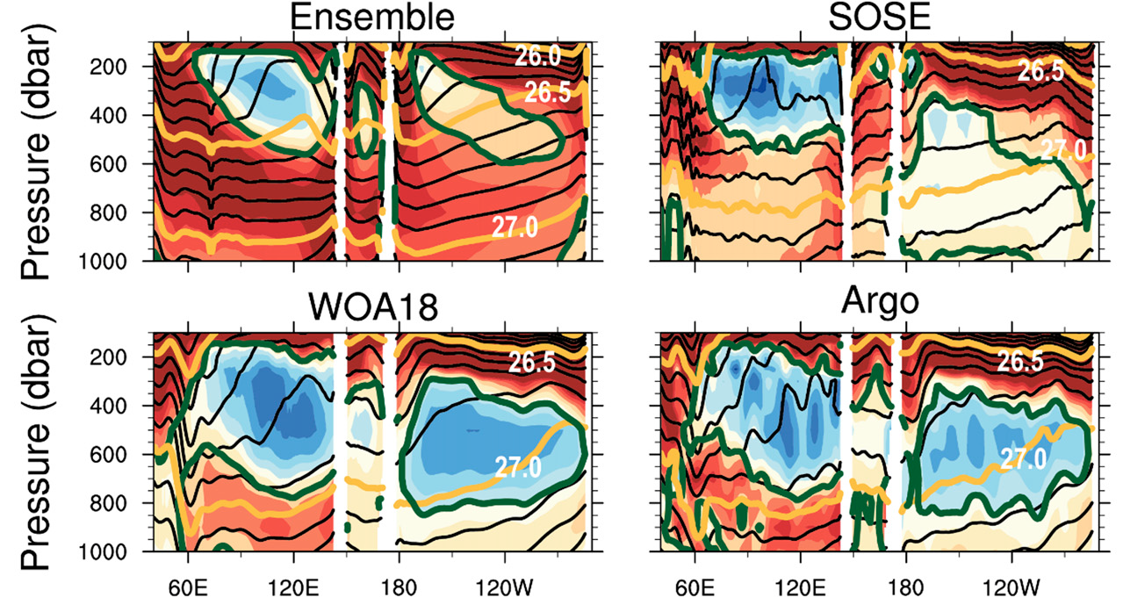
Ensemble
Argo
Simulated SAMW is thinner, shallower, lighter, and warmer than in observations, especially in the Pacific Ocean.
Biases in SAMW propagate to the thermocline waters in subtropical gyres.
dbar
Hong et al, 2021

Slide 4
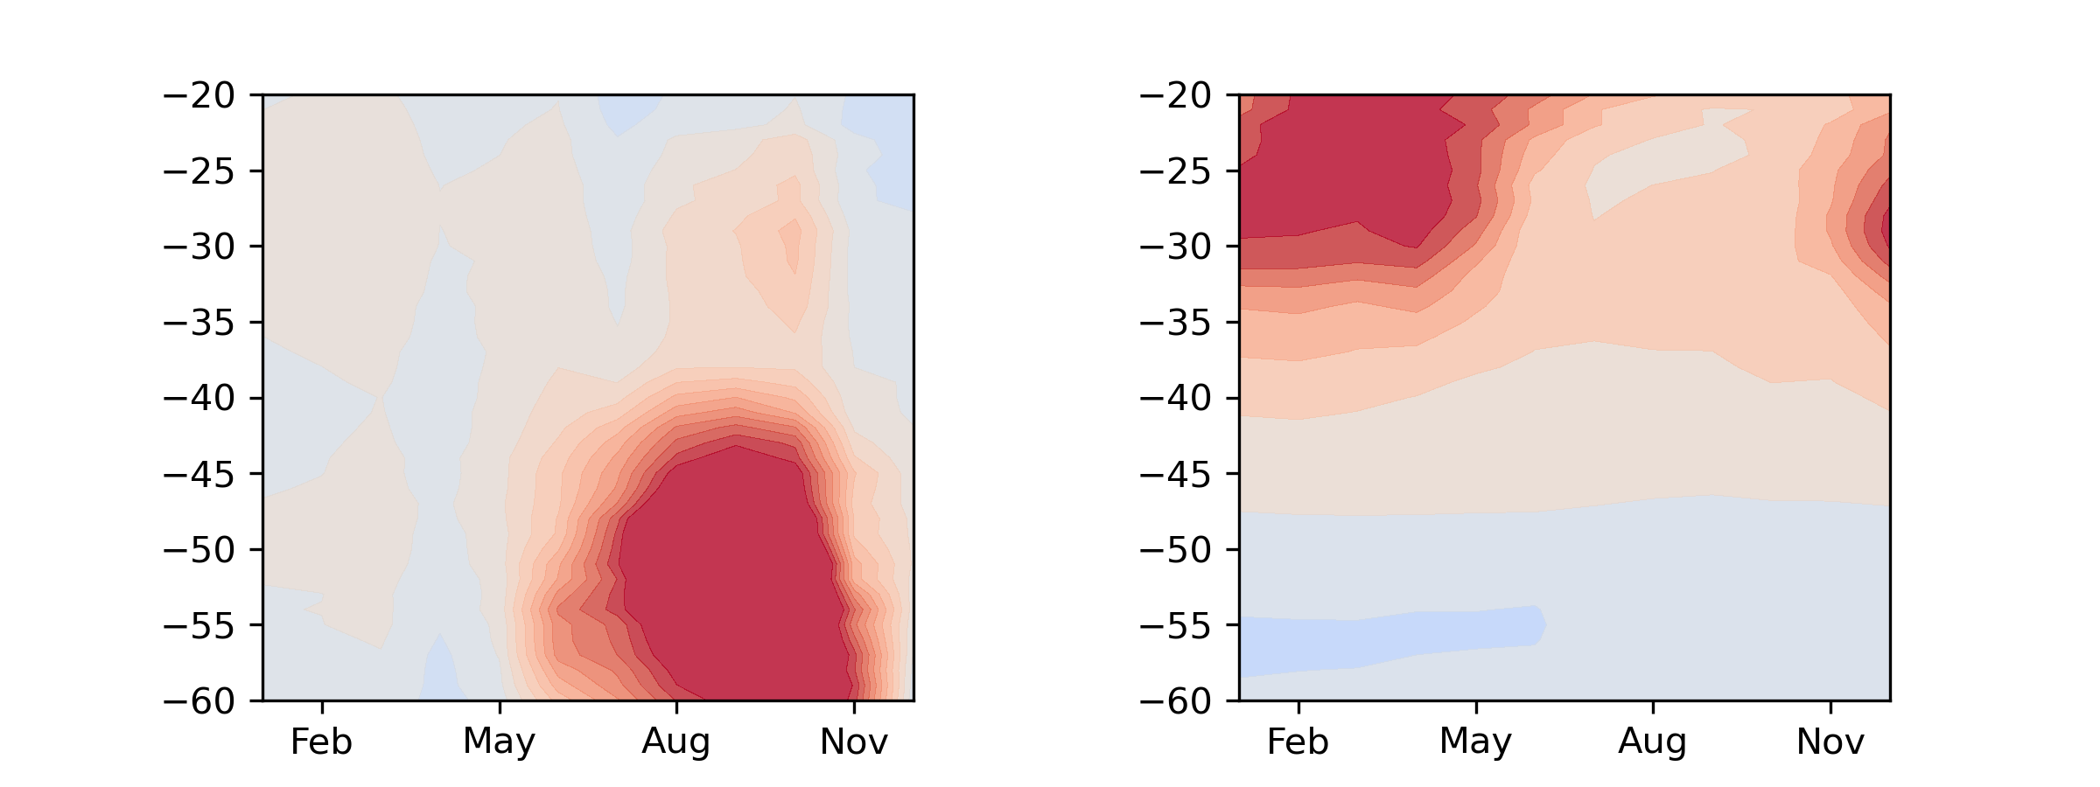
MLD bias
B3 bias

Slide 5
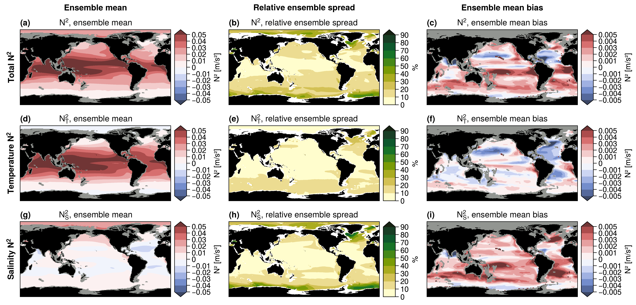
Vogt et al, 2024 (preprint)

Slide 6
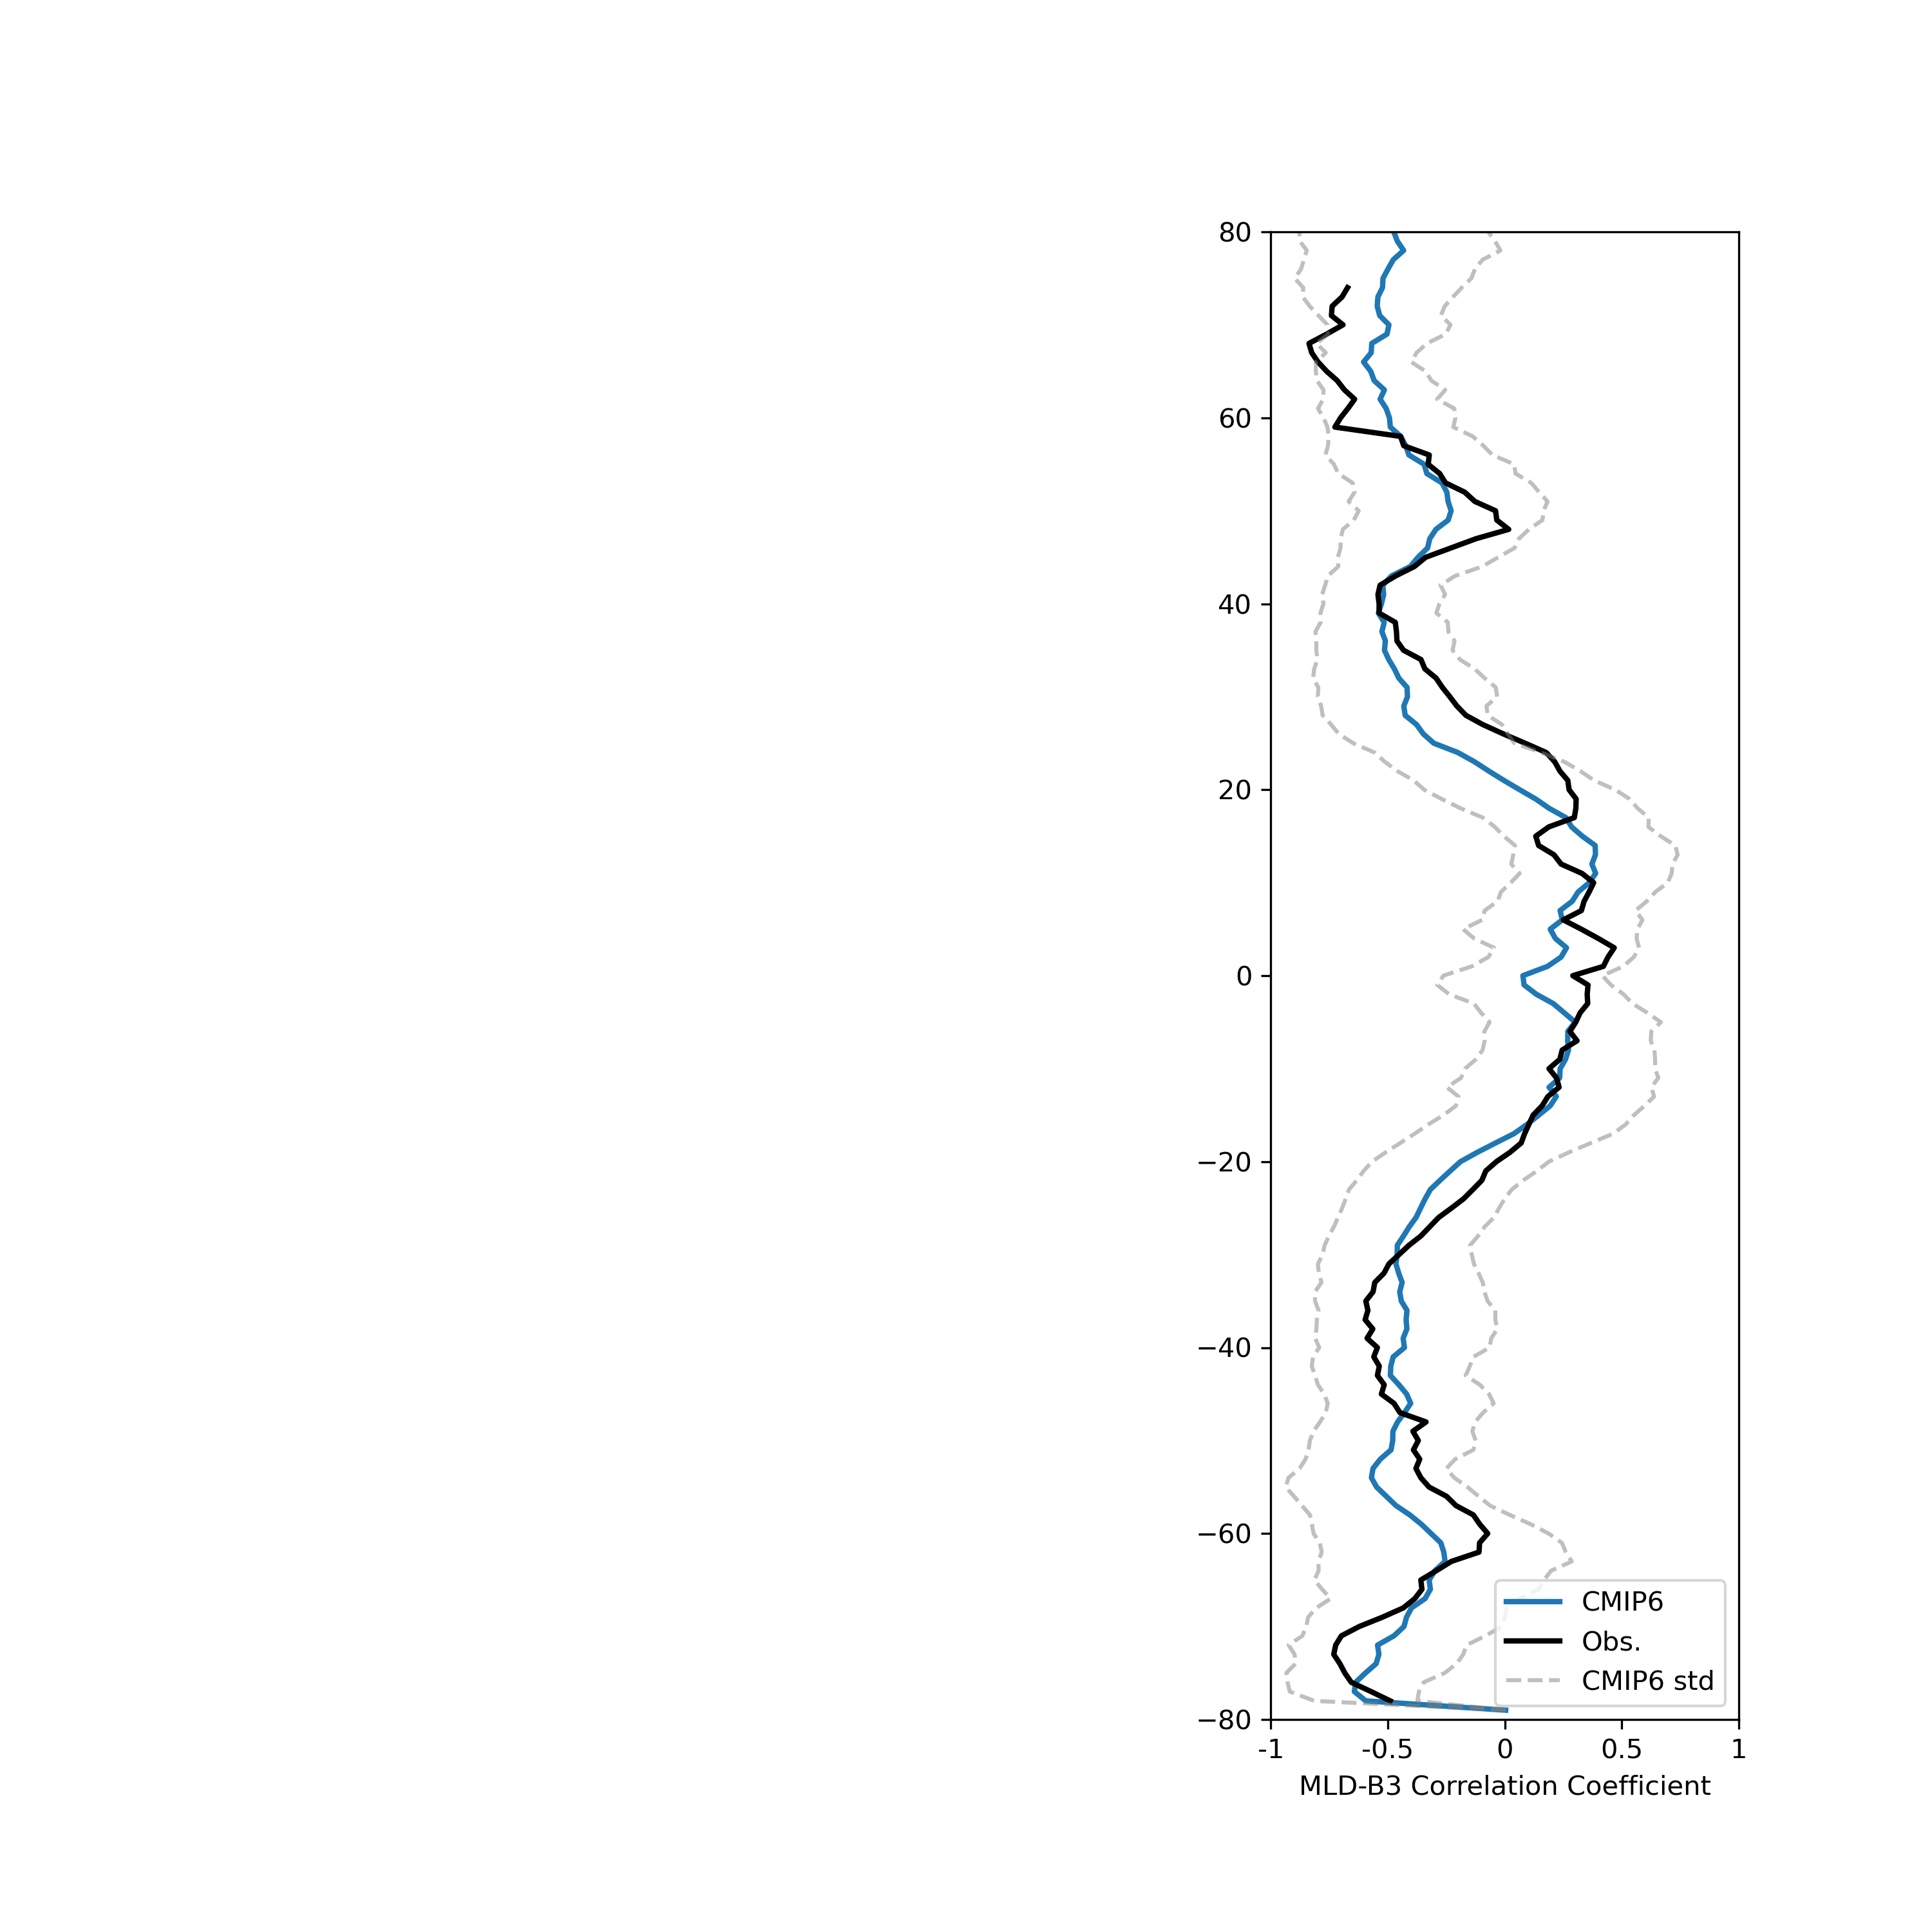
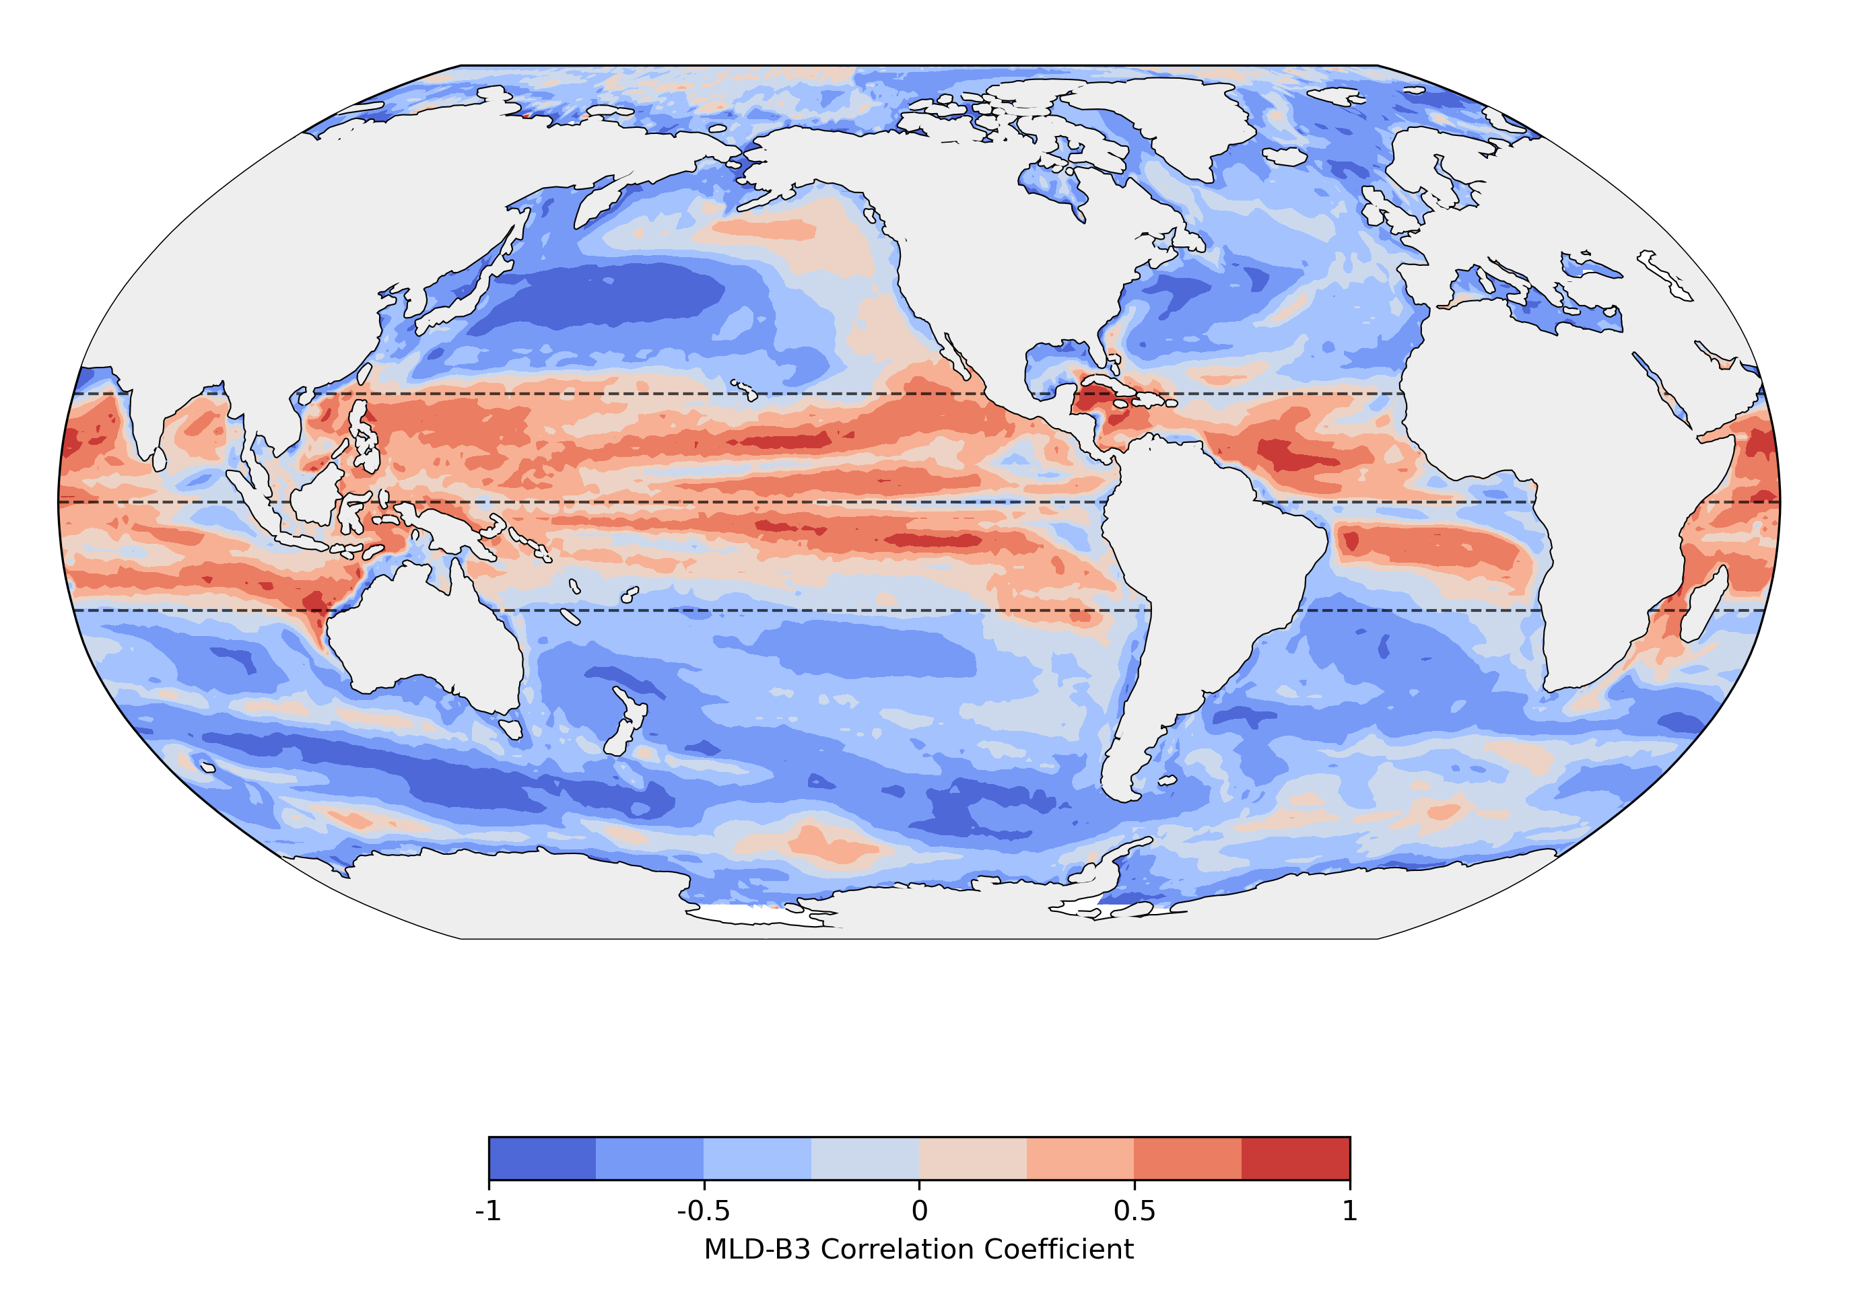
Correlation between MLD and main pycnocline

Slide 7
